Slide 1
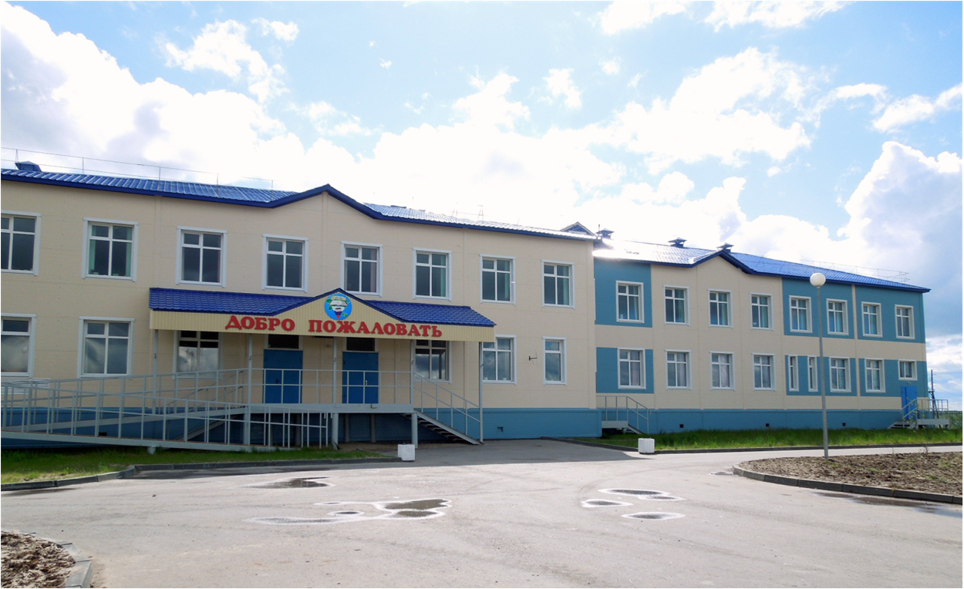
Всероссийский конкурс
«Учитель года России — 2014»
Использование регионального компонента в проектной деятельности учащихся как средство повышения мотивации
к изучению английского языка
Морокко И.Н.,
учитель английского языка МБОУ
« СОШ №2
г. Нарьян-Мара»
Ненецкий автономный округ

Slide 2
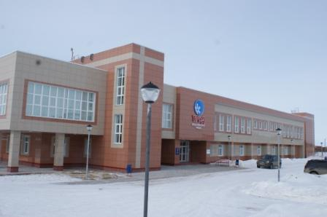
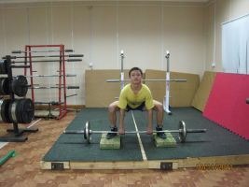
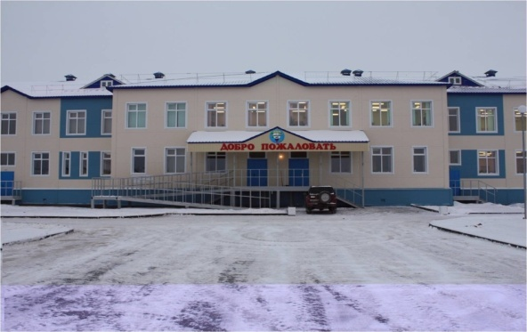
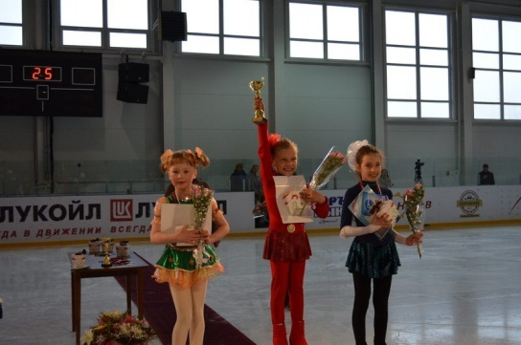
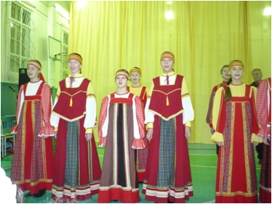
Воспитательное пространство

Slide 3
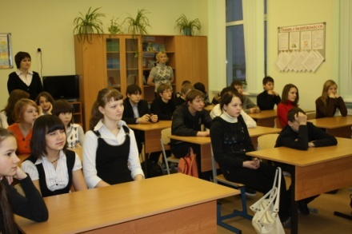
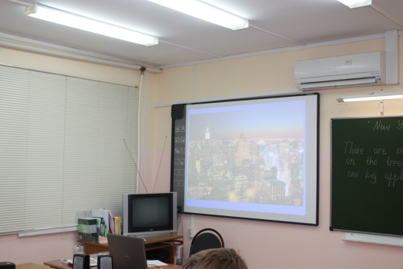
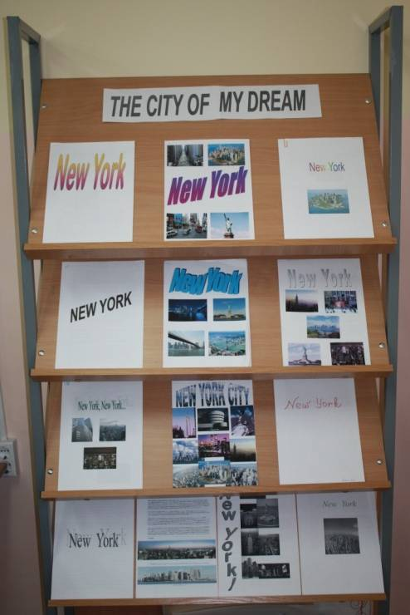
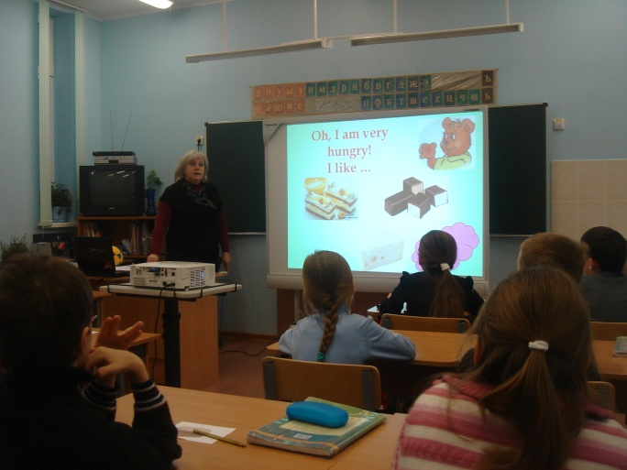
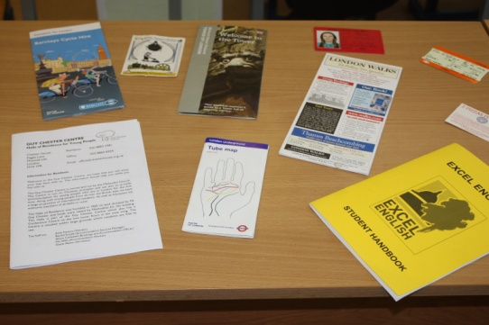
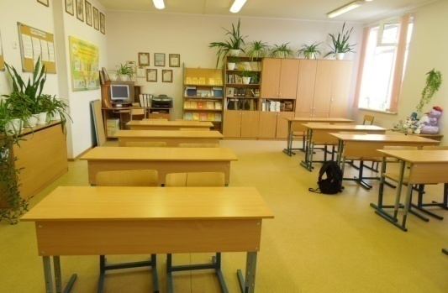
Условия возникновения опыта

Slide 4
Первичная диагностика
уровня мотивации учащихся

Slide 5
Актуальность темы
Базовые компетентности
современного человека
Информационная
Коммуникативная
Самоорганизация
Самообразование

Slide 6
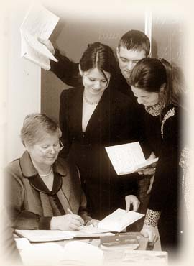
Противоречия
Потеря связи знаний с реальными потребностями
Объем знаний растет,
а время ограничено
Модель
выпускника современной школы
Недостаточность знаний для будущей жизни

Slide 7
Ведущая педагогическая идея
Ведущая педагогическая идея
Проектная технология
Региональный компонент
Информационно-коммуникативные технологии
Внутренняя мотивация

Slide 8
Методологическая основа опыта
Системно - деятельностный подход
(Б.В. Ломов, Л.С. Выготский, В.В. Давыдов)
Концепция внутренней мотивации обучения
(Е.И.Пассов, Г.В.Рогова, Л.М.Фридман, Е. Полат)
Метод проектов
(В.В. Рубцов, В.Д. Симоненко, Н.В. Матяш)

Slide 9
Новизна опыта
в комбинировании авторами нескольких методик для достижения положительного результата;
в создании системы работы по формированию исследовательских навыков учащихся при работе
над проектом на протяжении всего периода обучения английскому языку;
в создании банка ресурсов для осуществления проектной и исследовательской деятельности учащихся.

Slide 10
Технология опыта
Цель: формирование внутренней мотивации учащихся через использование проектной методики и организацию исследовательской деятельности на основе краеведческих материалов
Задачи:
Создать условия для вовлечения учащихся в творческую работу.
Способствовать формированию у учащихся исследовательских навыков.
Разработать банк проектных заданий и исследовательских работ по годам обучения.
Формировать у учащихся навыки работы с электронными средствами поиска и обработки информации.
Осуществлять мониторинг результатов проводимой работы.

Slide 11
Метод проектов - возрастной подход
Продолжительность
проекта
Уровень
мотивации
5-7 классы
8-9 классы
5-6 классы
7 класс
8-9 классы
Выбор мотивация
Уровень самостоятельности
5-6 классы 7 класс 8-9 классы

Slide 12
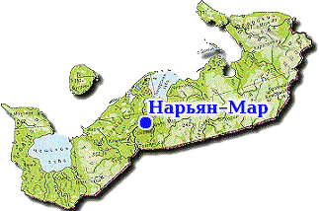
Проектная работа
«Новости с земли ненецкой»
Цели работы:
практическая – создание целесообразной вещи, которую практически можно использовать;
учебная – практическое овладение материалом по теме с использованием изученной грамматики и расширением лексики по теме( с выходом за пределы учебника);
воспитательная –воспитание у учащихся любви и внимания к родному краю; воспитание творческого подхода к изучению иностранного языка;
развивающая – развитие умения работать в коллективе, ставить цель, выбирать, отвечать за свой выбор, достигать цели и нести ответственность за полученный результат, а также умение презентовать и защищать его.
Предполагаемый практический результат : альбом о достопримечательностях города Нарьян-Мара. Практическая форма презентации- экскурсия.
Проект планируется на 6 уроков.

Slide 13
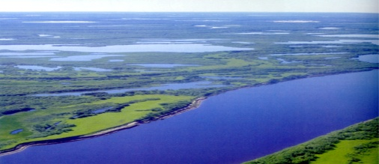
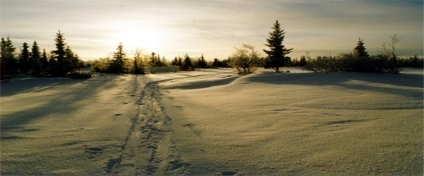
I. From the history
of Naryan-Mar.
Since 11th century Pustozersk has been the centre of great Pechorsky territory. But by the end of the century the fame of the town had subsided. It needed a new port centre in the Lower Pechora. The forest riches of the Pechorsky territory attracted foreign capitalists. The examples of wood things were exhibited in London and were highly appreciated. Many ships loaded up with timber left to foreign countries.
In 1903 the Swedish Company "Stella Polare" built a saw-mill at that place. After the October revolution it was burnt. In 1927 the saw-mill was restored by people from Archangelsk and other cities. In 1930 the biggest construction of the town began in the Lower Pechora. It was called Beloshelye at that time. This place was good for ships landing.
The first buildings were a house which had 8 flats, a hostel, a hospital and a post-office. In 1931 Beloshelye was renamed in the settlement of Naryan-Mar. It included Nosovo ( the settlement of Kachgort now), Karmanovo ( Gorodetsky ), Yokusha, Kalyush and the territory of timber plant.
On the 10th of March in 1935 the settlement was finally named in the town of Naryan-Mar. By that time some plants and trade enterprises had developed. Among them are a timber plant, a fish plant and some nenets organizations. The seaport exported timber.
n the thirties the airport organized flights to different parts of the Okrug. The House of Culture had been built by that time. In 1937 an amateur drama theatre was opened.
In the beginning of the fifties the full construction of the town began. A lot of schools, kindergartens, large blocks of flats and the central library were built at that time.
In 1968 the settlement of Iskately appeared near the town. It was the settlement of geologists. The first buses ran along the streets of our town in 1955.
.

Slide 14
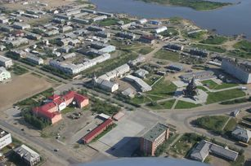
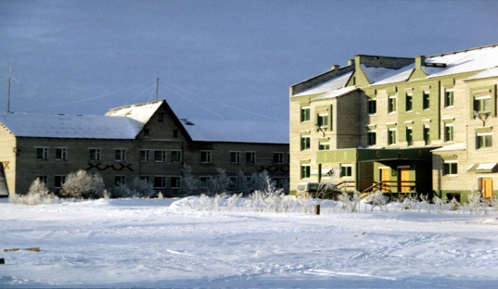
II. The Museum of Local Lore.
The regional Museum of Local Lore is situated in the big department store. It was opened in 1934 and had only 100 displays. A lot of historic and artistic treasures have been collected by selfless efforts of many enthusiasts. The collections are constantly being replenished by purchase, exchange, expeditions and donations. You can see many exhibits dealing with all aspects of Nenets life as well as development of economy, transport, trades and culture in our Okrug.
The Pustozersk Museum.
There is one more museum in Naryan-Mar. It is Pustozersk museum. Pustozersk is one of the brightest pages in the history of Russia, one of the most ancient settlements in the North of Russia. Since 11th century Pustozersk has been the centre of great Pechorsky territory. It was founded in 1499 by the order of the Tsar Ivan III.
Task: Complete the sentences with the needed words.
… was opened in … and had only 100 displays.
You can see many ….. dealing with all aspects of Nenets life.
…… is one of the brightest pages in the history of Russia.
……is one of the most ancient settlements in the North of Russia.
Pustozersk was founded in …. by the order of …….

Slide 15
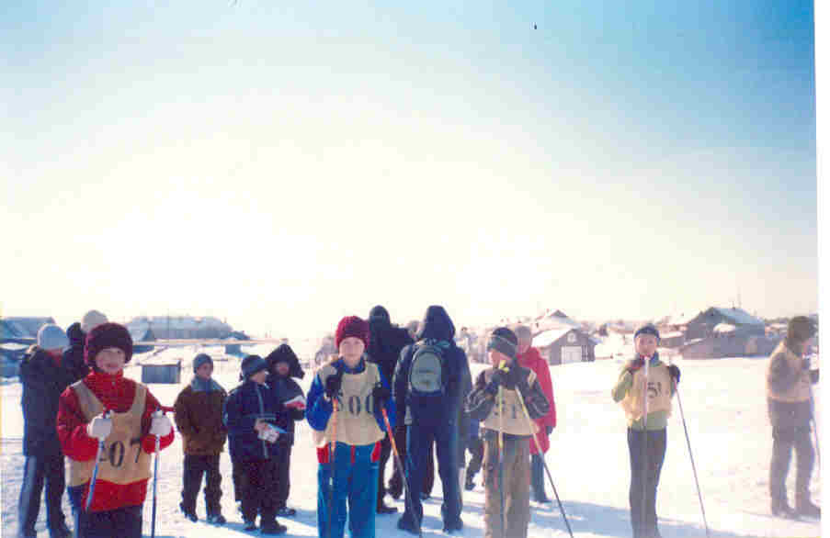
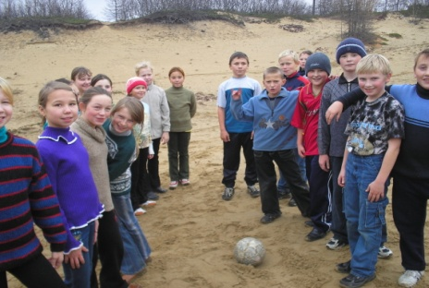
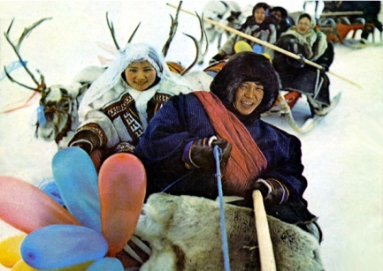
III. Sports in Naryan-Mar.
Everybody knows the proverb “Good health is above wealth”. Sport helps people to keep in good health.
There are many kinds of sport which are popular in our town: hockey, volleyball, basketball, skiing, football, athletics, tennis, wrestling. Many competitions are held in schools and in sport clubs by teachers.
In the Okrug the winters are long than summers. That`s why winter sport is more popular. For example, skiing is favourite kind of sport for many Naryan-Marians.
The capital of our Okrug is rich in its great traditions. Every year in winter we have skiing competition named “The Northern Lights”. First this competition was organized in 1969 by Chuprov Ivan Iosifovich. This man was the teacher of sport and the organizer of sport competitions in the Okrug.
Every year we have the cross named after Alexander Anufriev. There are many participants in this racing.
Some people prefer national kinds of sport. We must be strong to take part in such kinds of sport. There are amateur football teams in Naryan-Mar which play their matches in the Central Stadium. Among them are: Iskateley, the Bear.

Slide 16
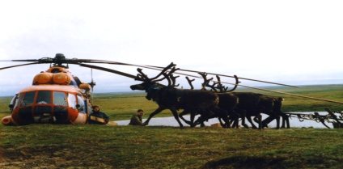
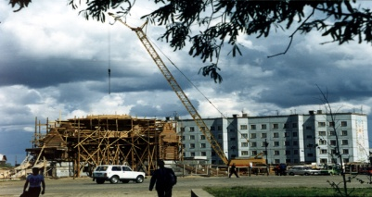
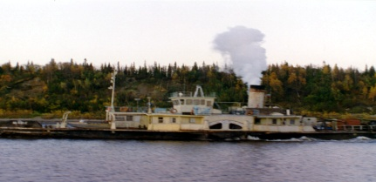
IV. Enterprises of the Okrug.
In Naryan-Mar there are few enterprises putting out consumer goods and foodstuffs.The most well-known are meat-processing plant, fish-processing plant, milk-processing plant. They put out canned fish, reindeer meat and milk products. There are workshops that produce articles made of the fur of sea animals, souvernirs, which are very popular among the population. Sometimes these workshops produce high boots from reindeer skins (pimy).
The local timber plant named after Khatanzeisky is the oldest enterprise in the Nenets Autonomous Okrug. Actually it doesn`t work now.
Another sigh of the economy modernization is springing up of the new types of enterprises: commercial banks, joint ventures, commercial shops.

Slide 17
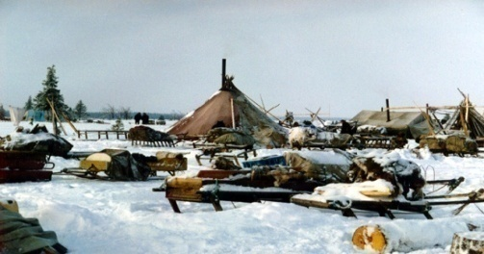
V. The famous people of the Nenets.
There are representatives of 75 nationalities in the Okrug. The Russian, the Komi, the Nenets make majority the population.
The Indigenous in our Okrug are the Nenets. The Nenets are engaged in traditional branches of economy such as hunting, fishing, reindeerbreeding. Reindeer are very important to the Nenets. They provide the nomads with most of their essential needs. The traditional Nenets food is reindeer products and fish.
Some Nenets lead a nomadic way of life. They live in their traditional houses called “chum”. It is made of special poles and reindeer skins. But many of the Nenets live in different settlements of the Okrug.
There are not so many holidays in the Nenets life. They have one of the most popular holiday “The Reindeer Day” in August. In this day the Nenets men and boys show their skills in managing of reindeer relay, complete in their traditional games.
There is boarding school for Nenets and other children from remote villages of the Okrug in Naryan-Mar.
Task: Agree or disagree.
1. The Russian, the Komi, the Nenets make majority the population.
2. The Nenets aren`t engaged in traditional branches of economy such as hunting, fishing, reindeerbreeding.
3. The traditional Nenets food is canned fish.
4. They live in their traditional houses called “chum”.
5. They have one of the most popular holiday “The Reindeer Day” in October.
6. Reindeer are very important to the Nenets.

Slide 18
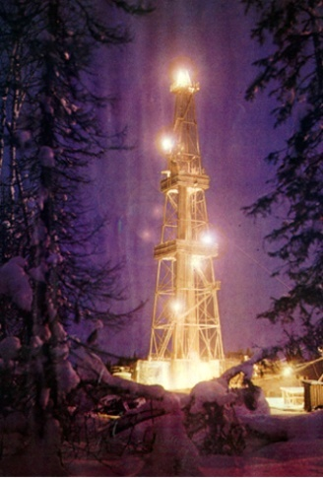
VI. Natural and mineral resources.
The Okrug is rich in natural and mineral resources. Deposits of coal were discovered long ago.
They are situated in the river basin Pechora. Industrial exploitation of coal deposits began in 1931.
Deposits of oil and gas were recently discovered by geologists. It was made in sixties. Much attention is given to putting these discoveries into exploitation. Development of oil and gas extraction demands modern technologies and great financial support.
The largest oil and gas bearing land Timan – Pechora is located comparatively close to Central Russia, but the greatest Russian project is in the process of negotiations.
Task: Answer the questions.
Is the Okrug rich in mineral resources?
When were the deposits of coal discovered?
When are they situated?
When were the deposits of oil and gas discovered?
What does development of oil and gas extraction demand?

Slide 19
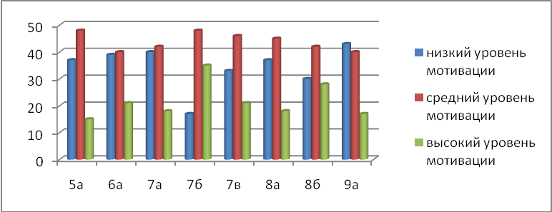
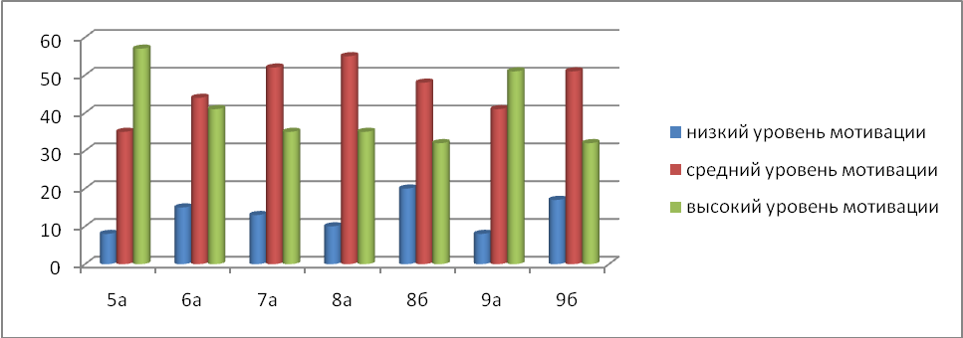
Положительная динамика уровня мотивации

Slide 20
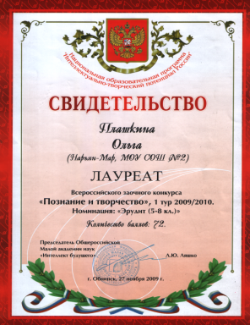
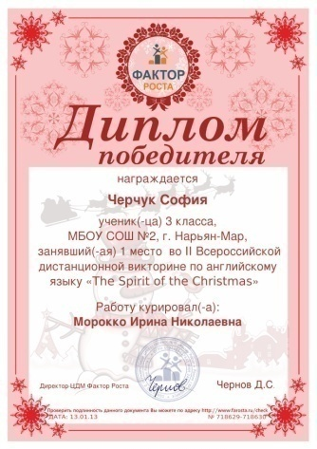
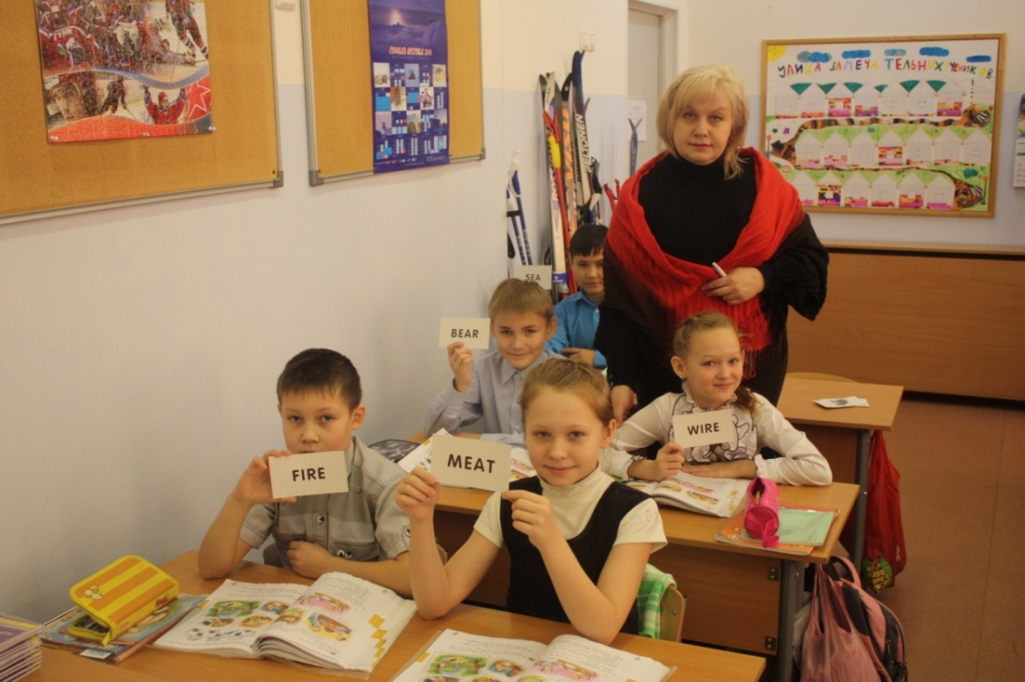
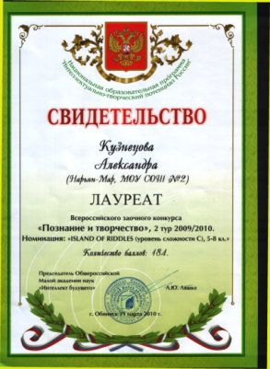
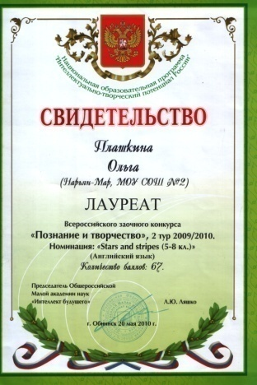
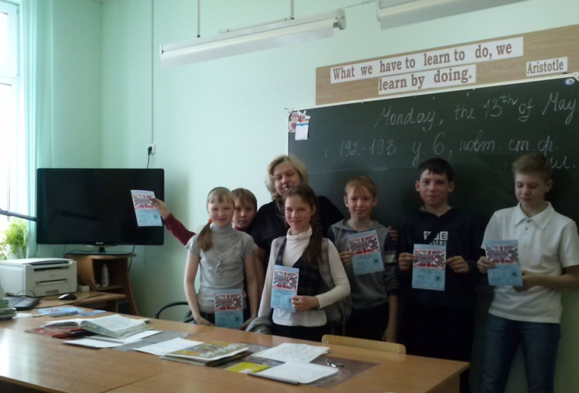
Результативное участие в конкурсах муниципального, регионального и Всероссийского уровней

